Slide 1
BNN Drill Communications Workshop
9/25/25

Slide 2
This Year We Have A Whole New Ballgame
Because We Are On Our Own!

Slide 3
NEIGHBORHOODS HELPING NEIGHBORHOODS
How do Neighborhoods connect with each other?

Slide 4

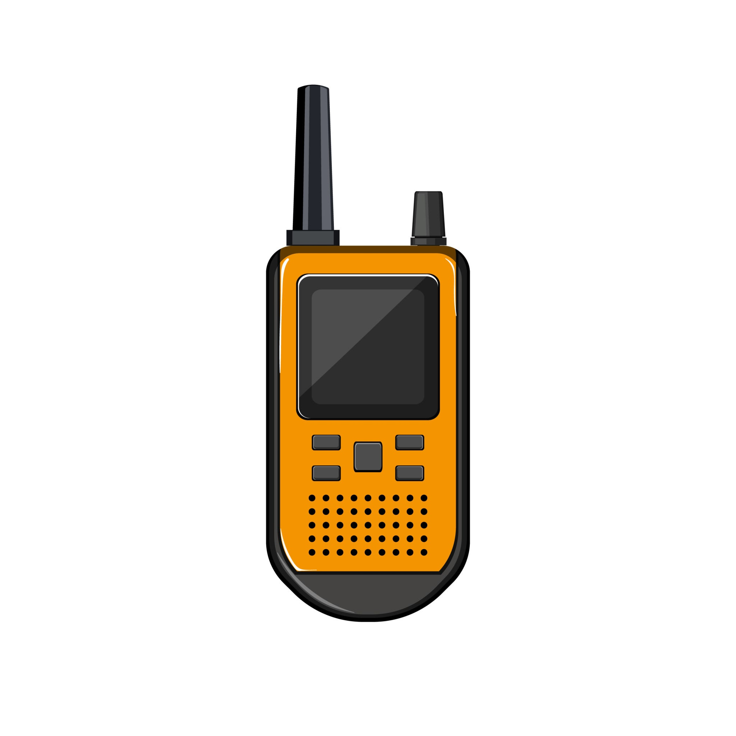
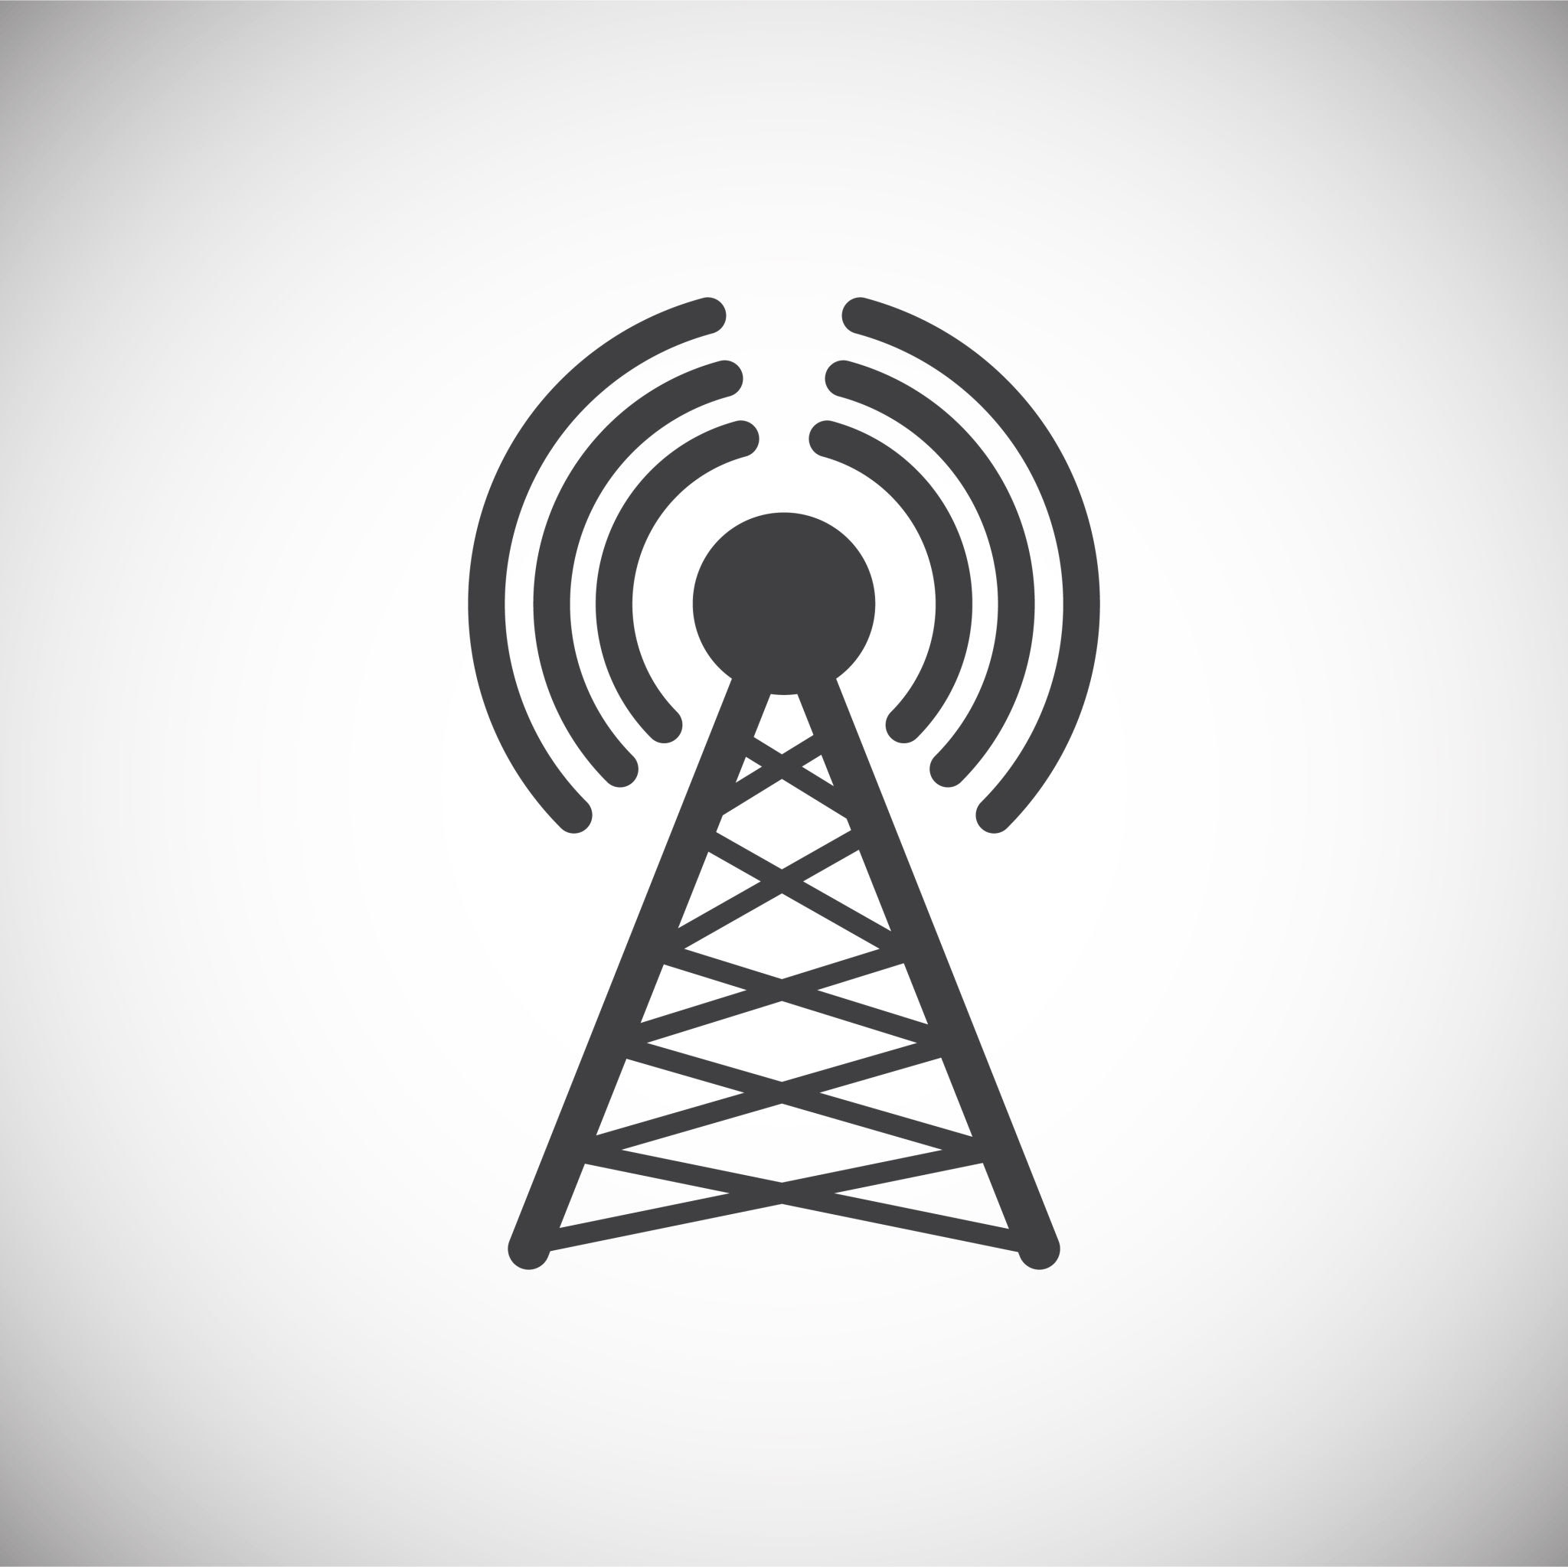
A New Trick this year: ZELLO app
And an Old Standby: FRS radio
And, when All Else Fails: HAM radio

Slide 5
Zello is an app that turns one’s cell phone into a Walkie-Talkie.
It may work when your cell phone does not.
One can also “message” or text using Zello.
Separate Channels can be set up for use by family, friends, neighbors.
Though it has unlimited range, it is dependent on cell tower/internet connectivity.

Slide 6
FRS radios can be used without a license to communicate typically 1-2 miles.

Slide 7
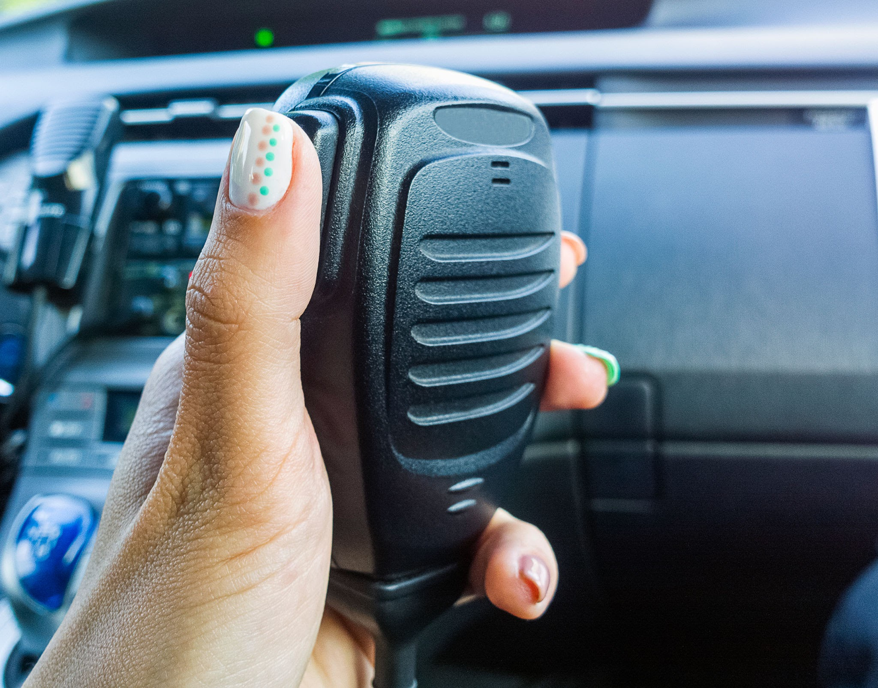
Ham radios require a license and can communicate many miles, including the entire City of Burlingame with few exceptions.

Slide 8
WHAT IS A RESOURCE NET?
It is a communication plan where neighborhoods can communicate with other neighborhoods to share resources.

Slide 9
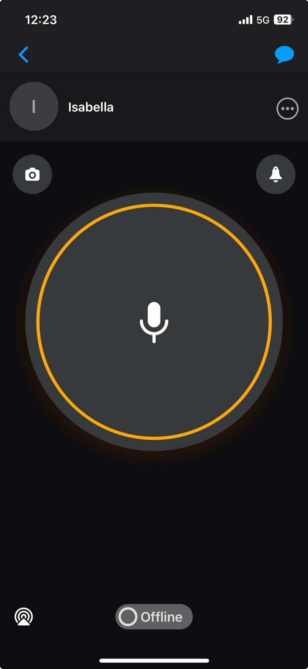
ZELLO
During the first half of the Drill (9-9:45 AM), a Resource Net will be activated using Zello. Neighborhoods will communicate their assigned NEEDS and RESOURCES to the Net Control via voice or message (text).

Slide 10
FRS/HAM RADIOS
During the second half of the Drill (9:45-10:30 AM), when a simulated cell/internet outage occurs, a Resource Net will be activated using FRS/HAM radios. Neighborhoods will communicate their assigned NEED during a roll call of neighborhoods by Net Controls. A Neighborhood’s RESOURCE will be offered when called for by Net Control.

Slide 11
REGIONS
For Drill radio communications, Burlingame will be divided by Broadway Avenue.
South region - those living and operating south of Broadway.
North region - those living and operating north of Broadway.

Slide 12
FRS CHANNELS
Those in the South region will use FRS Channel 5, DCS 1.
Those in the North region will use FRS Channel 6, DCS 11.
KNOW HOW TO PROGRAM YOUR FRS RADIO TO CHANGE CHANNELS AND PRIVACY CODE

Slide 13
HAM RADIO
HAM radio operators will be regional Net Controls monitoring their regional FRS channel and both the Burlingame repeater (BURL V: 146.805 Mhz (-) PL 192.8) and Simplex (BURL 1: 147.525 Mhz, PL 114.8). The primary frequency will be the repeater - BURL V.

Slide 14
HAM NET CONTROLS
HAM Net Controls will request RESOURCES in their region using FRS radios. If the RESOURCE is not available, they will relay the request via the repeater (BURL V) to the opposite region’s Net Controls.

Slide 15
HAM NET CONTROLS
Using FRS radio, those opposite regional Net Controls will then request their region’s neighborhoods for the RESOURCE. When it is found, that information will be relayed, via the repeater, back to the requesting region’s Net Controls who will notify the requesting neighborhood that its requested RESOURCE was found.

Slide 16
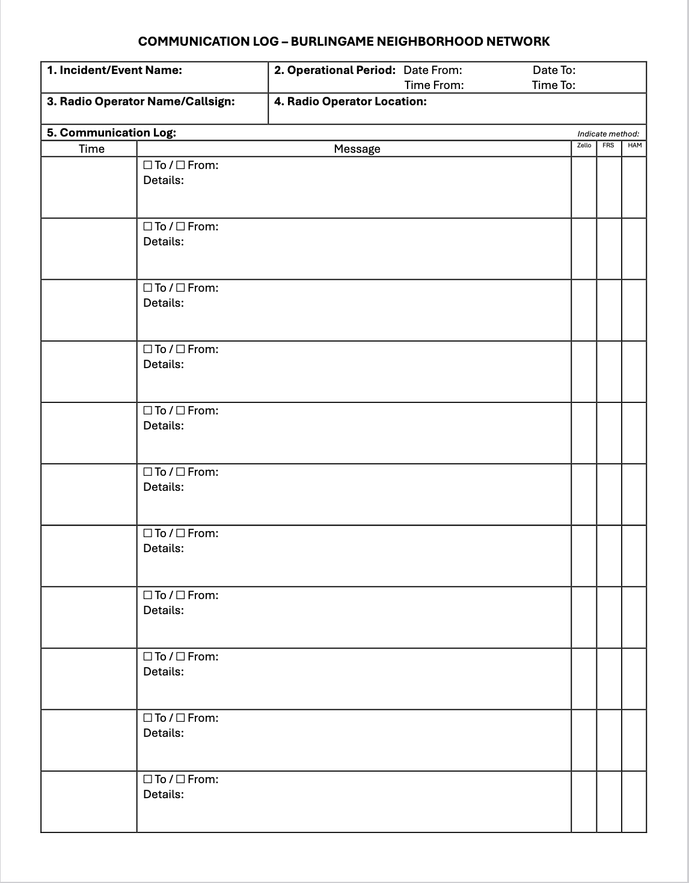
BNN Communication Log

Slide 17
BURLINGAME MAP

Slide 18
WORKSHOP
Pick up:
BNN Communication Logs, Neighborhood NEEDS and RESOURCES, FRS radios for new neighborhoods
Demonstration of how to operate an FRS radio (walkie-talkie):
Antenna vertical
First Listen
“Push-To-Talk” button should be Push-To-Pause-To-Talk button
Radio communication protocols: First state who you are calling, then identify yourself. Wait for acknowledgement. “over”, “copy”
Help with FRS programming.

Slide 19
WORKSHOP
Help with Zello (“BNN Zello Net” Channel, how to “message”, etc.)
HAM radio questions

Slide 20
QUESTIONS AND COMMENTS

Slide 21
THANK YOU!
Rik Kasuga
rik@burlingamenetwork.org
(650) 464-3726

Slide 22
