Slide 1
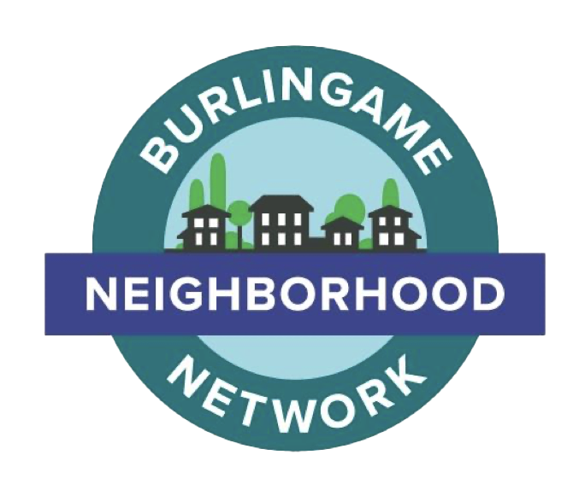
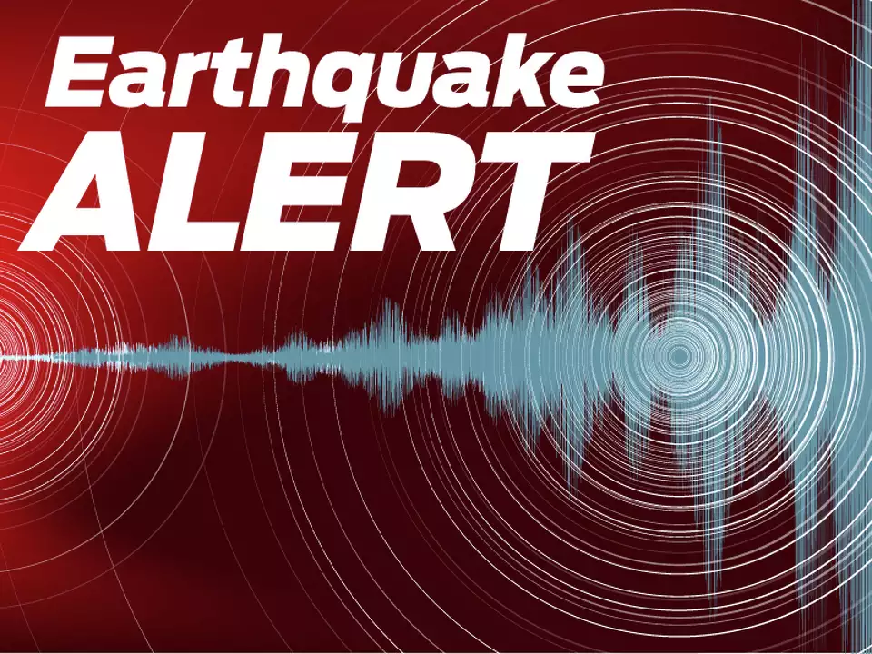
Drill Leader Training
Prepare your Block - October 4, 9 am
7.5 - Hayward Fault

Slide 2
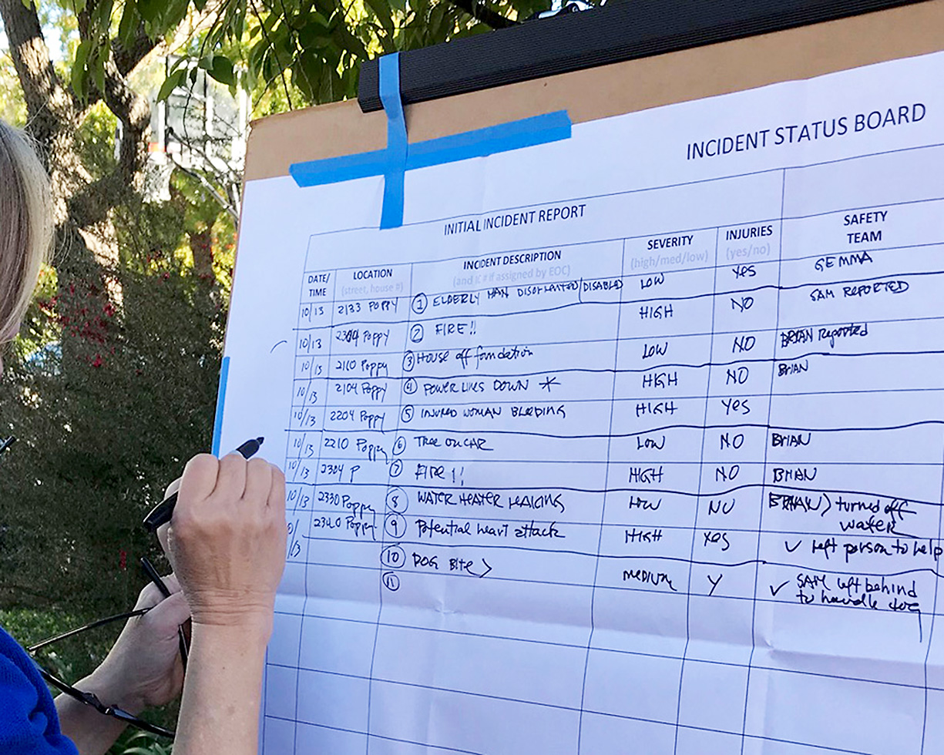
Drill Leader Training
Agenda
  Drill kit
  Recruiting neighbors
    Assigning the roles
  Emergency cache
  Steps in the drill
  Training video
  Communications

Slide 3
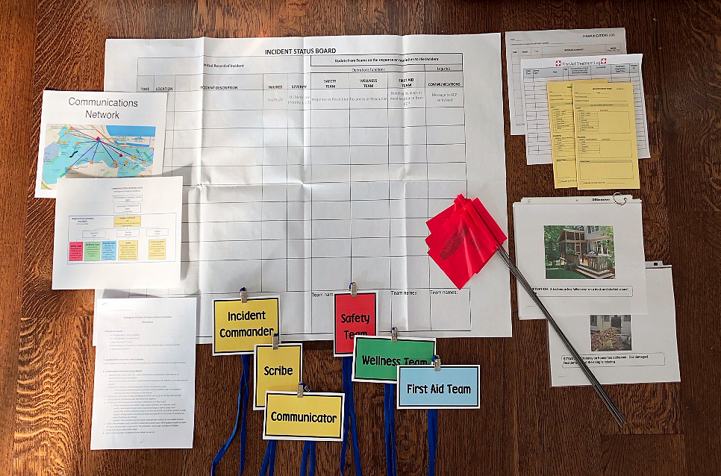
Drill Leader Training
Drill Kit contains materials needed for a successful drill
  The Script
  Role descriptions and badges
  Scenarios and flags
  Name tags for participants
  Incident report forms
  Scribe poster
  Ok/Help signs
  Evaluation sheets

Slide 4
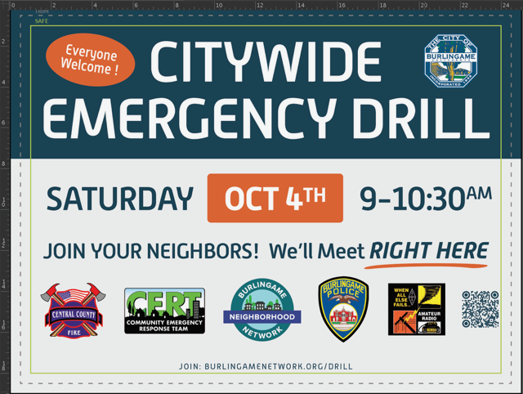
Drill Leader Training
Recruit neighbors
  Block roster with an email list
  Door-to-door
  Drop flyers
  Plant the lawn sign

Slide 5
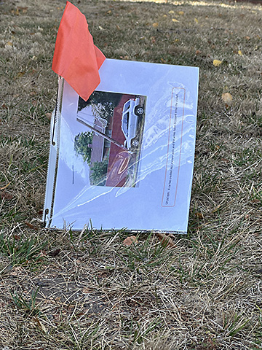
Drill Leader Training
Understanding the roles
  Incident Commander - Starts drill, assigns roles, wrap up
  Scribe - Collects Incident Report Forms and records incidents
  Safety Team – Look for physical hazards
  Well-Being Team – check on the needs of neighbors
  First Aid Team – Set up stations and administer first aid
  Communications – relays information
  Photographers`

Slide 6
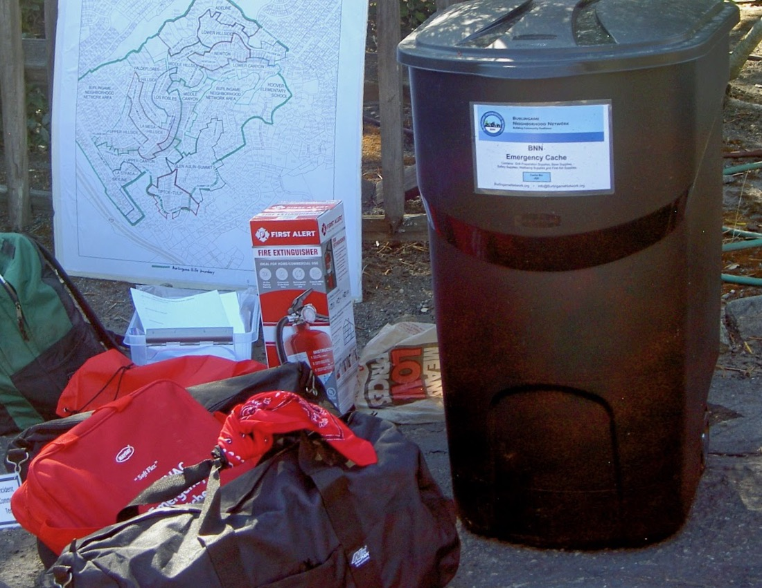
Emergency Cache
Active blocks can apply for a Cache filled with tools, first aid supplies, and other safety items
The Cache is stored by one of the neighbors with quick access in the event of an emergency
  What is in the cache?
    Tools
    First Aid supplies
    Stretcher
    Helmets
    Fire extinguisher
    And more
New drill blocks can apply for a cache for next year

Slide 7
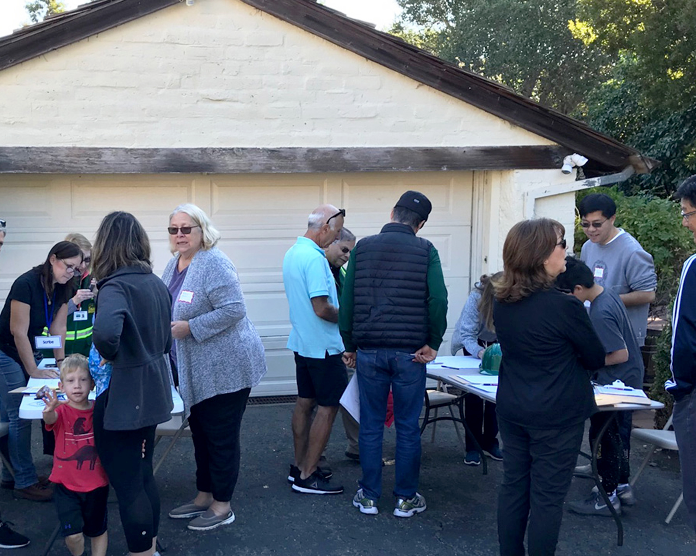
Drill Leader Training
Early morning duties
  Set up the command center
    Tables – signups – name tags – scribe area
    Treats – coffee, pastries, donuts
  Place scenarios on lawns
Start the drill – Use the script in your drill kit
  Assign roles
  Send out the teams
Police or fire personnel
Wrap up

Slide 8
Drill Leader Training
The Wrap up
  Discussion
  Evaluation forms
  Send all photos: Terry@Burlingamenetwork.org
  Collect the scenarios and flags
  Pack the drill kit

Slide 9

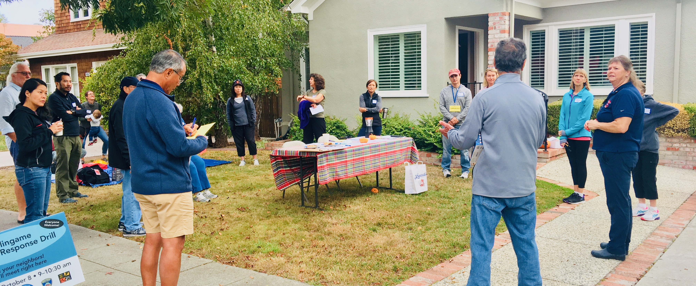




Mock Training Video

Slide 10
Communications
WE ARE ON OUR OWN

Slide 11

Communications
Neighborhoods may help other neighborhoods using a RESOURCE NET.
A RESOURCE NET is a communication plan where neighborhoods can communicate with each other

Slide 12
Communications
What communication tools will be used to facilitate a RESOURCE NET?
ZELLO in the first portion of the Drill.
FRS Radio/HAM Radio in the second portion of the Drill when a simulated loss of cell tower and internet connection occurs.

Slide 13
Communications
ZELLO is an App that allows your cell phone to act as a Walkie-Talkie.
Following a disaster, Zello may work when your cell phone does not. One can also “Message” or text using the ZELLO App.
Separate Channels can be set up for use by family, friends, neighbors. Though it has unlimited range, it is dependent on cell tower/internet connectivity.

Slide 14
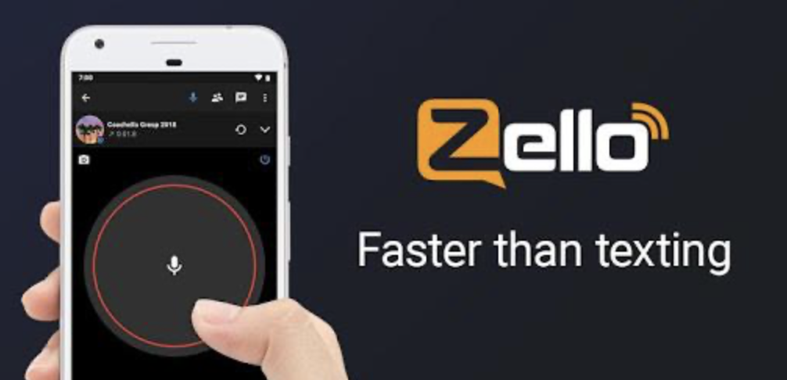
Communications
Demonstration of a Resource Net using Zello

Slide 15
Communications
Important Next Steps:
  *Tonight, take home your specific neighborhood NEEDs and RESOURCEs
  *Download the Zello App, create an account and search for and choose the “BNN Zello Net Channel”.
  *Charge up your FRS radio and bring it to the Communication Workshop on September 25, 2025, at 7-8:30 PM to learn more detailed information about Drill communications and how to make it work.

Slide 16
Drill Leader Training
Questions and Answers
Website: BurlingameNetwork.org
Send us an email and we will help
  info@burlingamenetwork.org
Thanks for attending and your help in making Burlingame a resilient community

